Slide 1
Python crash course

Slide 2
python
You are encouraged to run through the examples as they are presented
Short enough in most cases that you could input the code and see the same results as we proceed
I have a copy of the main file that I will be working with if you are interested.
You can download and install python (very easily at http://www.python.org)

Slide 3
Python crash course
Object oriented
not as much as squeak but a lot more than your average script language
Dynamic allocation
(no declarations necessary!)
Can run in interpreted mode
(from the interpreted prompt)
No parenthesis – forced indentation for scoping etc.

Slide 4
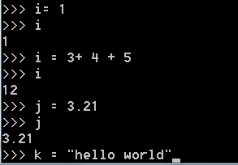
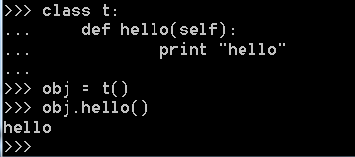
Everything is an object
Ints, floats, strings
Object definition via class
Also standalone methods

Slide 5
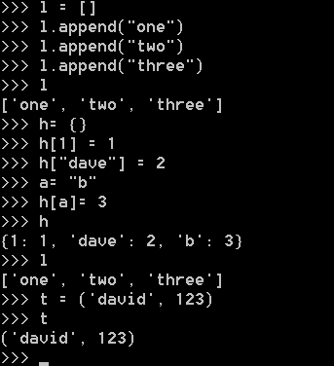
lists
lists
Hashes
tuples

Slide 6
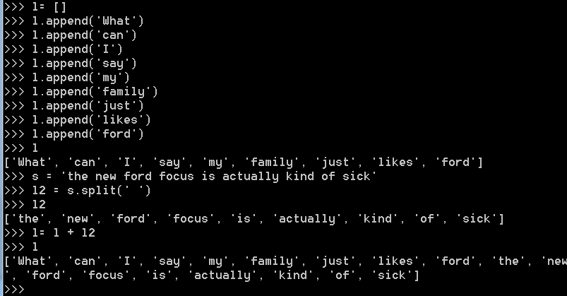
Consider text as “lists of words”

Slide 7
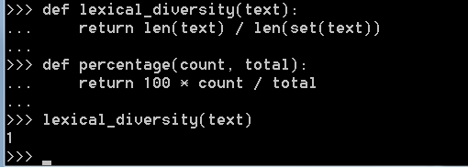
Methods
Methods can be created outside the realm of classic
“class” definitions

Slide 8
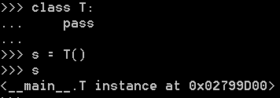
Formal classes as well can be used..(here ‘pass’ is equivalent parenthesis)

Slide 9
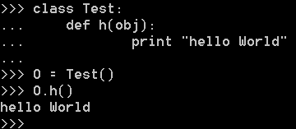
Hello World

Slide 10
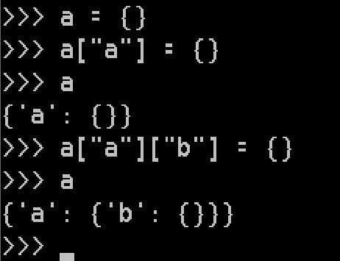
n-dimension associated arrays
Represent anything

Slide 11
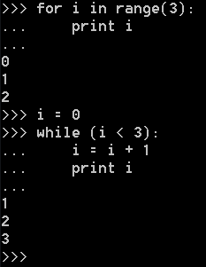
Event-based loops and looping constructs

Slide 12
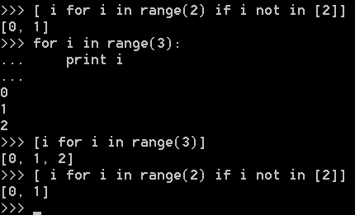
Logic inside of lists
Toby segaran (lists)

Slide 13
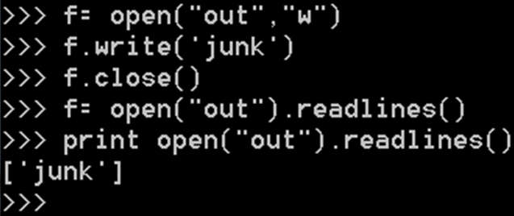
Python file I/O
One line of code does it (start to finish)

Slide 14

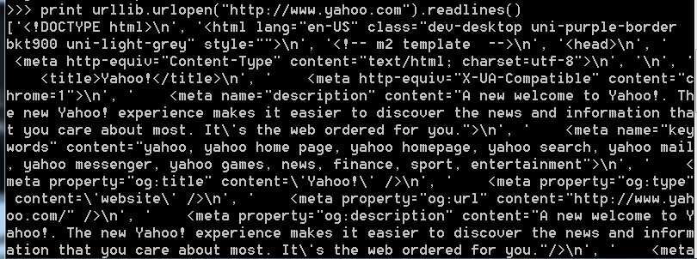
Reading in a file – a url opens and reads exactly the same as a file

Slide 15

Import libraries
Python api
Or user defined

Slide 16


Last but not least
Ironpython
jython

